Slide 1
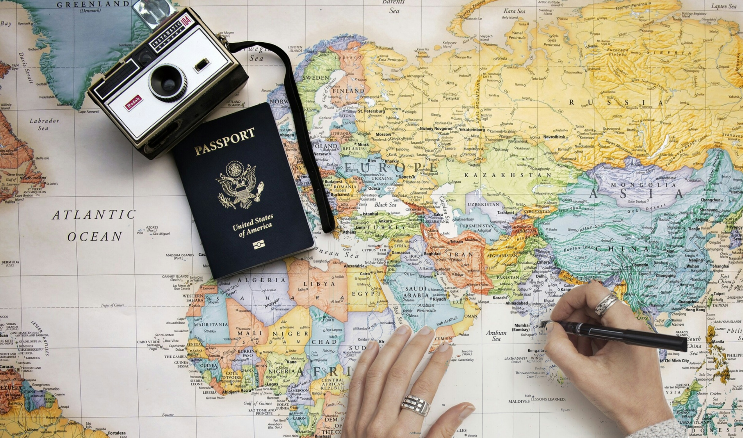
Department Travel Card Reconciliation Process
Department Travel Cards are issued to an individual who is an active SLAC employee (e.g., Travel Administrator), and is assigned as the cardholder for a directorate/department. The cards should only be used for pre-authorized SLAC travel-related purchases for new hires, visitors, sponsored guests and non CWR-SU employees such as Stanford University faculty, staff, students, postdocs and fellows.
Prepares Invitation Letter
Receives Invitation Letter
Receives Invitation Letter
Department Travel Admin
Sponsored Guest/Visitor
Travel@SLAC
Emails a copy to travel@slac.Stanford.edu
Fills out COVID-19 Resource Center Attestation
Reviews Service Now Incident
Receives approval from Travel Office via Service Now Incident
Receives Approval to Travel
Provides Approval to Travel
Makes travel arrangements using the SLAC Dept. T- Card and SLAC Booking Channels
Access Sponsored Guest Account
Supports any inquiries pertaining to travel arrangements
Creates Sponsored Guest Account
Travels and incurs various compliant expenses
Receives Expense Report(s)
*Reconciles SLAC Travel Card Transactions in Concur and ensures to provide required documents
Reports actual expenses and provides required documents on Expense Report
Audits Expense Report(s)
Receives Approval on Expense Report
Receives Payment
Approves Expense Report(s)
*Department travel admins only reconcile SLAC Department Travel Card transactions; they do not report any out-of-pocket expenses for Sponsored Guests/Visitors on their Concur Expense Report.
Airfare is purchased and travel arrangements are made
Helpful Links:
SLAC Travel Policies
Concur Quick Start Guides
SLAC Travel Card
Adding JP Morgan Expenses Quick Start Guide
Creating a Sponsored Guest Account

