Slide 1
Travel@SLAC
Supporting the Mission
Angel Jimenez
April 23, 2021

Slide 2
Objective & Agenda – What We Will Cover
Objective
Based on travel metrics, relocation takes the most amount of time to process and approve. This presentation is being provided as a solution to streamline the process / approvals.
Agenda
Relocation Expense Types
Direct Billing – SLAC authorized Moving Vendors
Concur – Account Set Up
Creating a Relocation Expense Report
Q&A

Slide 3
RELOCATION
(delete this slide if not used)
To change color, right click and choose “format background”
Choose from theme colors (blue, green, purple or orange)

Slide 4
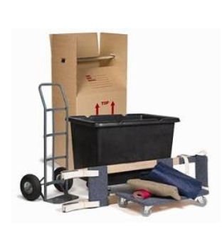
Relocation Expense Types
Relocation
Relocation Expenses incurred by new employees without hiring a SLAC approved moving company (vendor)
Examples;
Mileage, Airfare, Car rental
U-haul, moving equipment
Moving Companies (NON SLAC VENDOR)

Slide 5
Relocation Expense Types
Direct Billing
Relocation Expenses incurred by hiring a SLAC approved moving companies (vendor)
Examples
Ace World Wide
Atlas Van Lines
Stevens Worldwide Van Line
These can be found on Travel@SLAC’s relocation webpage

Slide 6
DIRECT BILLING
What is a Direct Bill?

Slide 7
What is a Direct Bill?
Direct Bills are expenses incurred by employees using SLAC preapproved moving companies (vendors).
Direct billing expenses are paid directly to the vendor by SLAC.
Direct bills are subtracted from the total relocation allowance stipulated on the offer letter and are not reimbursable to the employee via a Concur expense report.

Slide 8
Direct Billing Process Simplified
Employee contracts a SLAC authorized moving company.
Moving company provides a customized moving estimate to the Travel office.
Travel approves/denies the estimate.
Vendor moves the employee’s household goods.
The moving company sends travel the final invoice.
Travel treats this invoice as a Direct Bill and pays it accordingly.

Slide 9
DRAFT
Travel@SLAC – Relocation Direct Billing Process
Contacts Moving Company
and sets up move
New Hire
Start
Travel Approval Process
Set up estimates with New Hire
Helpful Links
Relocation Webpage
Direct Billing Vendors
Moving Company
Sends estimate invoice through Service Now asking for approval
Travel
Accounts Payable (AP)
Receives estimate invoice from ServiceNow
Is the Offer Letter and relocation agreement attached to ServiceNow Ticket?
Reach out to new hire
for the offer letter / relocation agreement
Receives Offer letter and relocation agreement
No
Receives email from Travel about offer letter / relocation agreement
Yes
Sends Offer Letter/ relocation agreement to Travel
Email HR Recruiter for conformation on start date and relocation amount
Receives estimate invoice from ServiceNow
Audits the estimate based on the offer letter and relocation amount
Travel Approval Process
Send out the estimate approval email to moving company
Is the estimate approved?
Receives approval from Travel
Yes
Moves household goods
listed in estimate
No
No
Missing information
Estimate
goes over relocation amount
Bills Travel Office for final invoice
Ask for Missing information
Tells new hire to pay overages
Receives final invoice
Sends missing information
Pays overages
Create Direct Bill package of estimate and final invoice
Sends missing information
Asks moving company for new invoice
Direct Bill Package:
Estimate invoice
Estimate approval from Travel
Revisions (if any)
Relocation agreement
Offer letter
Confirmation of start date and Relocation amount from HR recruiter
Relocation code 56111
P-A code
Obtain PA Code for Direct Bill Package
Audits the estimate based on the offer letter and relocation amount
Receives information
Sends Travel Updated Invoice
Is the estimate approved?
Contact Admin for PA Code
Direct Billing Audit Conducted
PA Code is in Concur
Receives new estimate from the moving company
Yes
No
No
Missing information
Estimate
goes over relocation amount
Approval Process
Final Invoice is Approved
Ask for Missing information
Tells new hire to pay overages
Sends PDF document to AP
Sends missing information
Pays overages
Voucher is created by AP
Sends missing information
Asks moving company for new invoice
New Hire
Voucher starts approval process
Travel Approval Process
Moving Company
Receives information
Sends Travel Updated Invoice
Travel
Provides final approval
Accounts Payable (AP)
Payment is processed
Receives new estimate from the moving company
Receives Payment
End
Acronyms
AP – Accounts Payable
DOE – Department of Energy
ISO – International Services Office
TER – Travel Expense Report
Revision 1.0

Slide 10
CONCUR
Account Set Up
To change color, right click and choose “format background”
Choose from theme colors (blue, green, purple or orange)

Slide 11
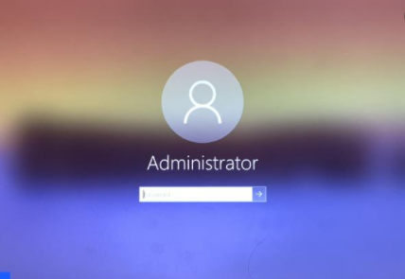
Login Information
When a new hire is made, HR creates a Windows account that is accessible on their first day of work.
This Windows login information grants access to; Outlook, iAT timesheets, VPN, Egencia & Concur.
When an employee cannot sign into their Concur account due to login challenges, SLAC IT needs to be contacted.
The Travel Office cannot make changes to login information due to segregation of duties.

Slide 12
Assigning a Delegate
Admins can help employees complete their relocation expense reports.
The Travel Office can assign the admin as a delegate in Concur to make changes.
Delegates can only help edit the expense reports, they are not authorized to submit them.

Slide 13
Creating the Relocation Expense Report

Slide 14
Required Documents for Expense Reports
Reimbursements & Non-PO Transactions
Expense Report Preparation - The traveler is required to prepare an expense report in Concur to account for all travel costs reimbursed by SLAC. The completed expense report should be submitted within 10 working days after returning from each trip. If out of pocket expenses are not submitted within 60 days of the traveler returning from their trip, justification is required in Concur and may be subject to tax reporting under IRS rules
Invoice, itemized receipt, rental agreement, itinerary that shows the last 4 digits of the credit card used
If transaction is >$75
Documentation is required
Always Include
Proof of purchase
OR
Invoice, itemized receipt, rental agreement, itinerary with the credit card statement that shows the transaction
Expense receipt examples:
Airfare | Ground Transportation | Car Rental | Lodging | Training / Registration | Relocation
Tickets or itinerary indicating dates and times of departure, ticket/ confirmation numbers, class of service, fare basis, and cost of ticket along with proof of payment (e.g., card being charged). | Transportation Tickets - passenger copies of rail, bus, and boat tickets indicating dates and times of departure, ticket/ confirmation numbers, class of service, fare basis, and cost of ticket along with proof of payment (e.g., card being charged). | Rental Car Agreements/ Bills - original car rental agreements or invoices. Car rental expense. Requires itemized receipt indicating dates and times of pickup, car class charged, proof of payment | Hotel Bills - itemized lodging bill or express checkout itemizing room rates and taxes including proof of payment. Meals charged to the lodging bill will not be reimbursed– as these are paid as part of M&IE per diem. | Proof of payment required with the last 4 digits of credit card or a form of “Paid” Acknowledgement. | Offer Letter Relocation Agreement Moving Company final invoice

Slide 15
CONCUR WALKTHROUGH

Slide 16
The Reporting Header
Project, activity, WBS, and Fund:
Fill in your project number and Concur will help narrow down the selections for the remaining dropdowns
Trip Type:
Trip types Relocation, Visitor, and Other Reimbursement should not be selected under the Pre Approved Trip policy.

Slide 17
Entering the correct Expense
Personal Mileage v Relocation Mileage
They have different reimbursement rates.
Personal Mileage is for all other expense report types
Relocation mileage is only for relocation expense reports
Entering in the correct expense type can ensure the correct reimbursement
GSA RATES
M&IE (itinerary) v Actual Meals
Concur’s required fields may not be intuitive .
In order to use the M&IE expense type, you need to have entered in an Itinerary
Relocation expense reports do not require itineraries, they actually end up creating an exception and stop the report from being submitted
Use “Actual Meals” expense type instead

Slide 18
The Importance of Correct Dates
It is important to enter in the correct dates to ensure accurate reimbursement for audit purposes and for identifying potential taxable income.
Example;
If my first day of Lodging is January 5th, then the expense date should represent January 5th.

Slide 19
Who can submit the report?
Due to segregation of duties, Travel analysts cannot make monetary adjustments to any expense report nor can we add or change the Project / Activity codes.
Only the new employee may submit the expense report. No one else.

Slide 20
Quick Start Guide Links
Quick Start Guides - Webpage
Basic Concur Training
Expense Type Breakdown
Creating an Expense Report (Detailed)
Allocating Expense to Multiple Project-Activity Codes
Attaching Receipts to an Expense Report
Creating a Flight Comparison
Logging in to Enter or Change Bank Information
Creating an Expense Report for Relocation Expenses

Slide 21
Common Misunderstandings

Slide 22
Lodging and M&IE
SLAC policy provides 21 days to fully relocate within a one year period.
Max of 21 days worth of expenses
Max of 21 days of lodging
Max of 21 days of actual meals
Days of Lodging and actual meals must match
Example Scenario; You fly in and stay in a hotel for 10 days before moving into your new home, you should only be expensing 10 days worth of actual meals for yourself.
Meals
Lodging

Slide 23
Proof of Payment
Proof of payment is required with all expenses $75 and greater.
Acceptable forms
The last four digits of a credit card number being present on the receipt.
Copy of a credit card bank statement:
Check

Slide 24
Proof of Payment on Cash Receipts
Cash payments still require proof of payment.
Acceptable forms of proof:
Receipt of ATM cash withdrawal
A letter written by vendor
EX. If you are lodging was paid in cash, the landlord can write a confirmation of payment

Slide 25
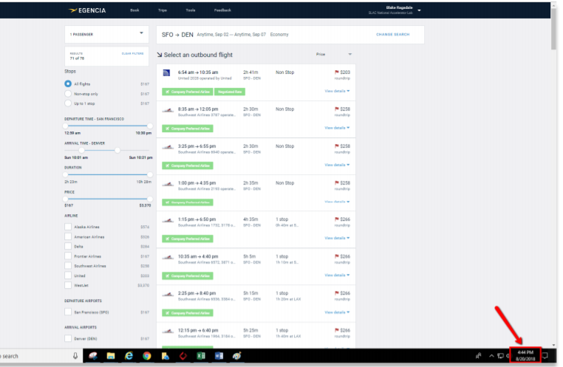
Flight Comparison

Slide 26
ANY QUESTIONS?

